Slide 1
Energy and Water Balance
September 17, 2019

Slide 2
Pre-class ice breaker → write down your answer
Are urban areas cooler than close-by rural areas? Why or why not?
Why are polar areas warming at a faster rate than equatorial areas?
Why are greenhouse gases warming the Earth?

Slide 3
The surface energy budget

Slide 4
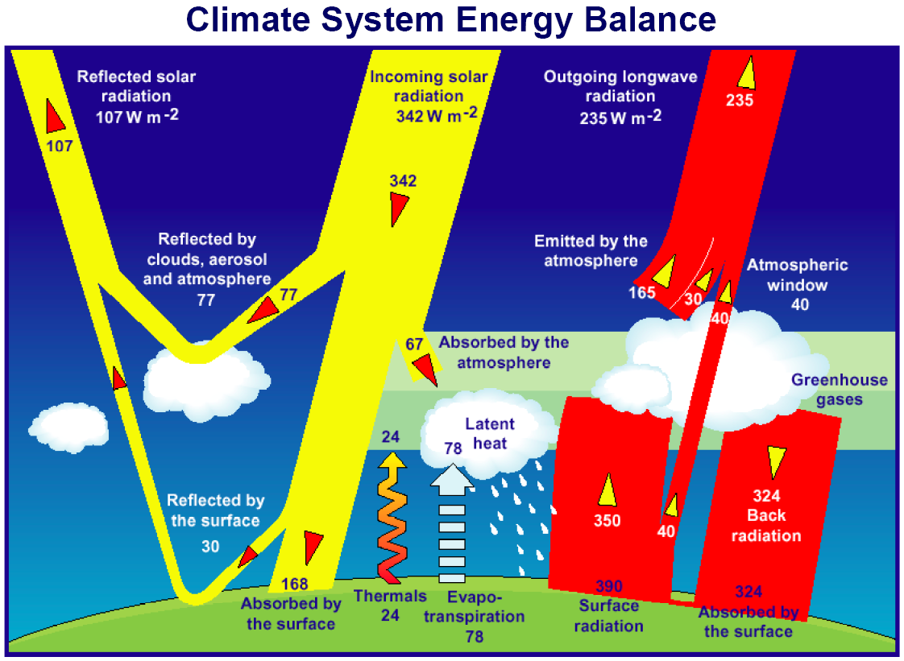

Slide 6
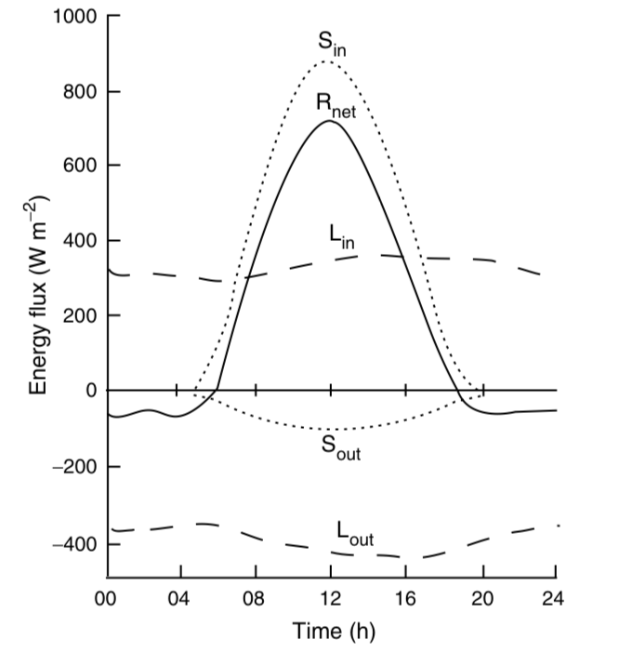
The net radiation absorbed by a surface is a sum of ingoing and outgoing radiation
K
K

Slide 7
The net radiation absorbed by a surface is a sum of ingoing and outgoing radiation
K
R_{net} = (K_{in} – K_{out}) + (L_{in} – L_{out})
K

Slide 8
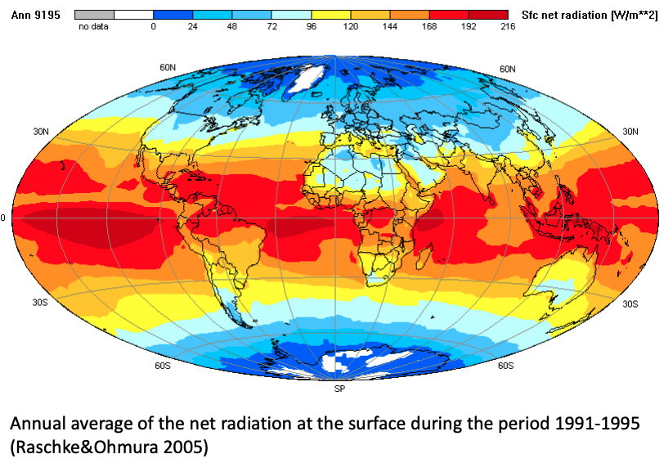
R_{net}

Slide 9
Shortwave (K) depends on the albedo (α)
K
R_{net} = (K_{in} – K_{out}) + (L_{in} – L_{out})
R_{net} = (1– α)K_{in} + (L_{in} – L_{out})
K

Slide 10
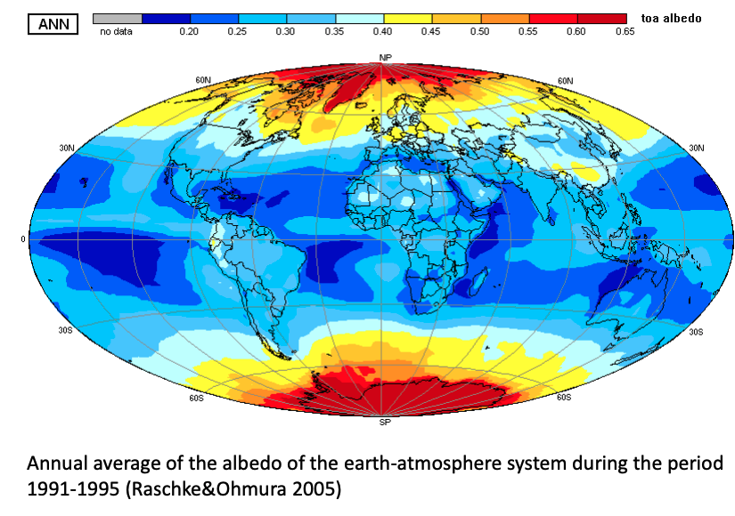
α

Slide 11
Longwave (L) depends on temperature (T)
K
R_{net} = (K_{in} – K_{out}) + (L_{in} – L_{out})
R_{net} = (1– α)K_{in} + (L_{in} – L_{out})
R_{net} = (1– α)K_{in} + (L_{in} – L_{out})
L_{in} = σε_{sky}T_{sky}⁴
L_{out} = σε_{surface}T_{surface}⁴
ε = emissivity
σ = Stefan-Boltzman constant
K

Slide 12
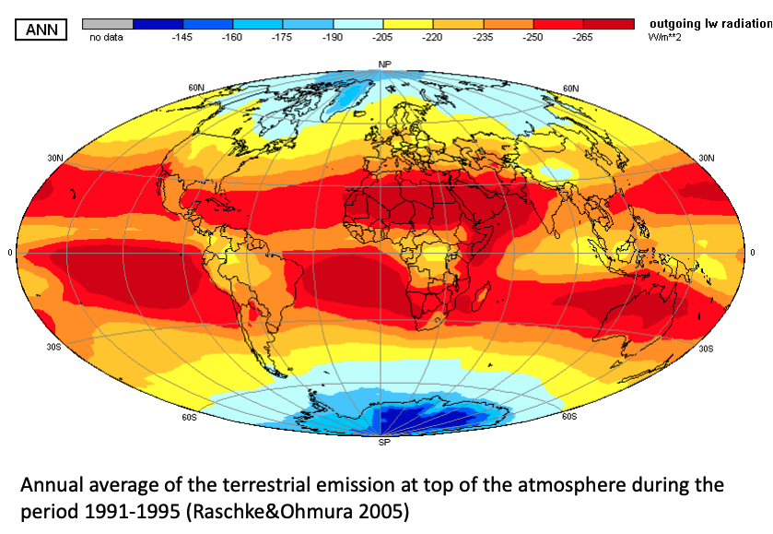
L_{out}

Slide 13
Net radiation absorbed is partitioned into non-radiative fluxes

Slide 14
Net radiation (R_{net}) is partitioned into different fluxes at the surface
R_{net} = H + LE + G + ∆S

Slide 15
Net radiation (R_{net}) is partitioned into different fluxes at the surface
R_{net} = H + LE + G + ∆S
Total radiation absorbed by the surface

Slide 16
Net radiation (R_{net}) is partitioned into different fluxes at the surface
R_{net} = H + LE + G + ∆S
Sensible heat flux (heats air)

Slide 17
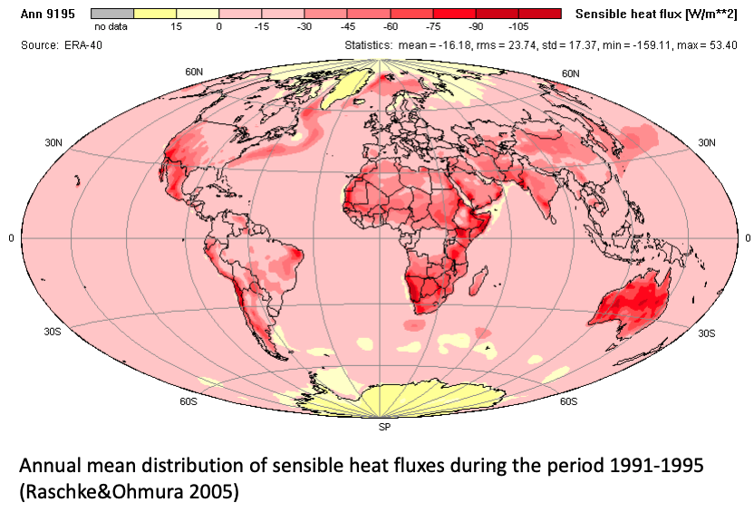
H

Slide 18
Net radiation (R_{net}) is partitioned into different fluxes at the surface
R_{net} = H + LE + G + ∆S
Latent heat flux (water evaporation; no T change)
L = latent heat of vaporization (constant)
E = evapotranspiration

Slide 19
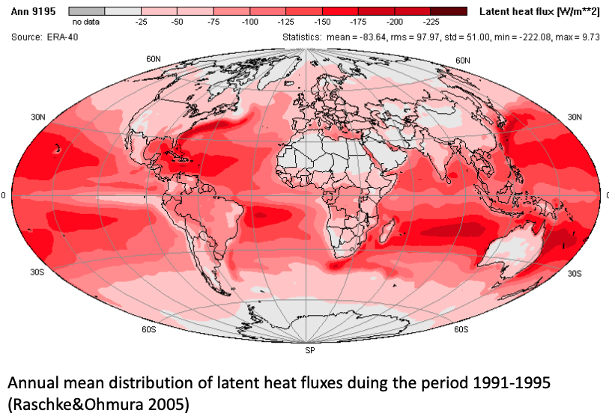
LE

Slide 20
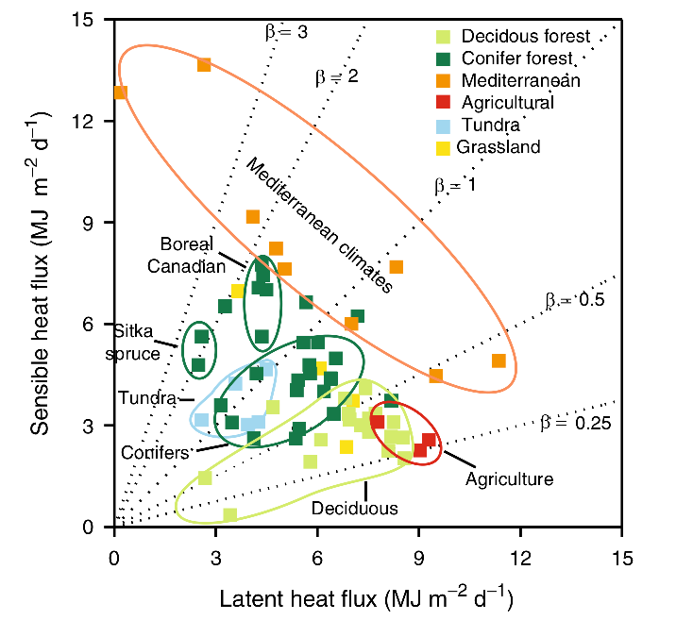
Bowen ratio – ratio of sensible (H) to latent (LE) heat flux (H/LE)
What do you notice from this figure?

Slide 21
Bowen ratio – ratio of sensible (H) to latent (LE) heat flux (H/LE)
Low transpiration/ Dry ecosystems
High transpiration/Wet ecosystems

Slide 22
Bowen ratio – is spatially and temporally variable
Desert - High
Spatial – turbulence within and between ecosystems
Temporal – snowmelt, bud break
Tropical Rainforest – Low
Tight linkage of energy and water budgets

Slide 23
Areas with high Bowen ratios tend to have higher air temperatures for a given amount of R_{net}

Slide 24
Net radiation (R_{net}) is partitioned into different fluxes at the surface
R_{net} = H + LE + G + ∆S
Ground heat flux (heats ground; typically small)

Slide 25
Net radiation (R_{net}) is partitioned into different fluxes at the surface
R_{net} = H + LE + G + ∆S
Storage

Slide 26
Class activity → turn in for participation point
Answer the beginning of class questions using the energy budget equations:
Are urban areas cooler than close-by rural areas? Why or why not?
Why are polar areas warming at a faster rate than equatorial areas?
Why are greenhouse gases warming the Earth?

Slide 27
Surface energy budget recap
Important biological characteristics
Albedo
Transpiration (latent heat flux)
Coupling with terrestrial water cycles
Influences atmospheric water demand
Influences atmospheric water storage

Slide 28
Half-baked climate solutions!
Idea: open up stomata to crank up photosynthesis to increase carbon uptake
Would this impact climate?
Openness of stomata
Photosynthesis
Medlyn et al. (2011)

Slide 29
Higher photosynthesis
Smith et al. (2017)

Slide 30
Higher photosynthesis
More latent heat flux
Smith et al. (2017)

Slide 31
More latent heat flux
Local cooling
Smith et al. (2017)

Slide 32
Water budget

Slide 33
Questions
How does water enter a terrestrial ecosystem?
Where does it go?
Outputs
Storage

Slide 34
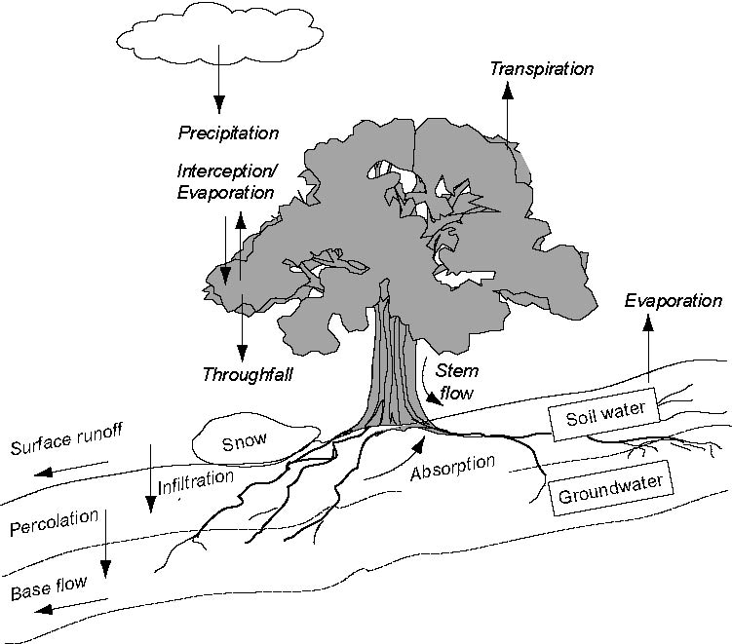

Slide 35
The Water Budget Precipitation +/- Storage = Evapotranspiration + Runoff

Slide 36
The Water Budget P +/- ∆S = E + R

Slide 37
The Water Budget P = E + R +/- ∆S

Slide 38
Water moves through ecosystems via potential gradients

Slide 39
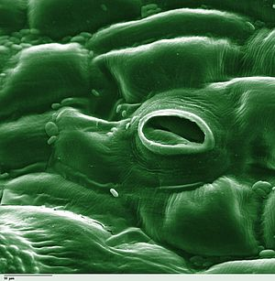
Water moves from high water potential to low water potential via a continuous water column/film

Slide 40
Remember: soil water potential depends on soil texture

Slide 41
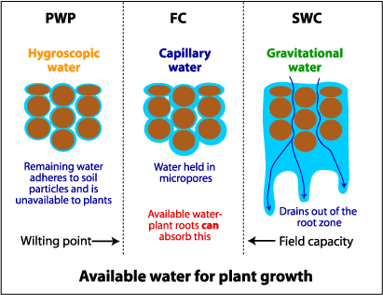

Slide 42
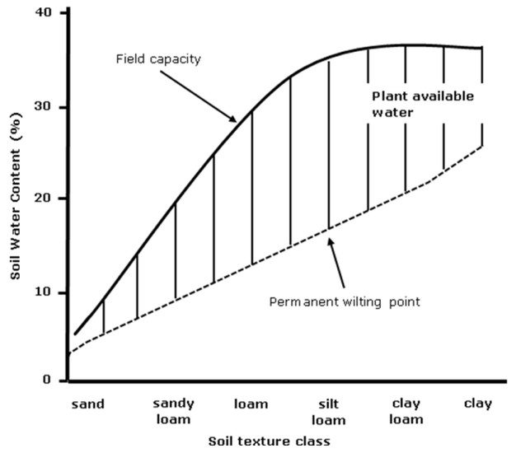

Slide 43
Coupling to the energy budget: Transpiration

Slide 44
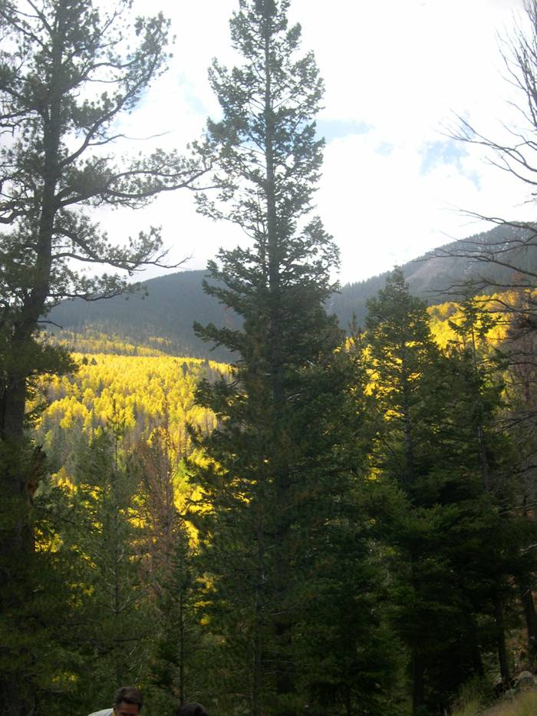
Transpiration is positively related to soil water availability…
(Fischer et al. 2003 Tree Phys.)

Slide 45
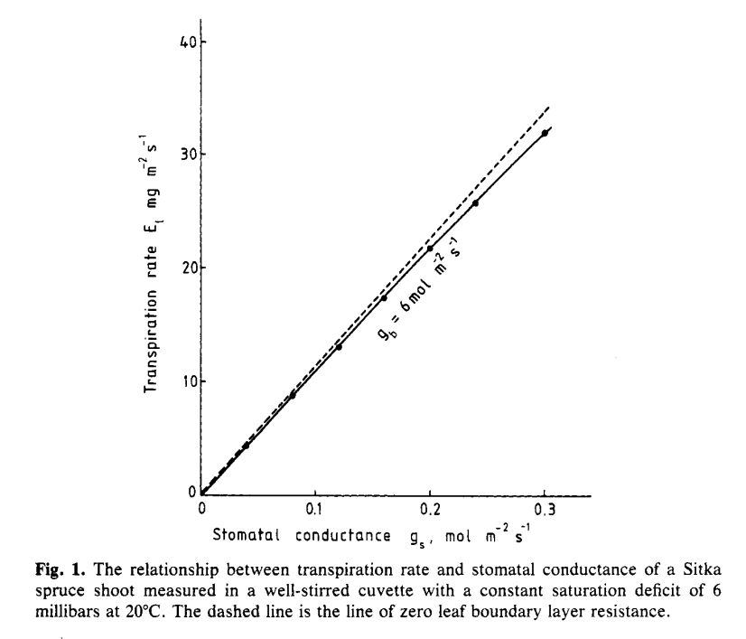
…and stomatal opening…
Jarvis and McNaughton (1986)

Slide 46
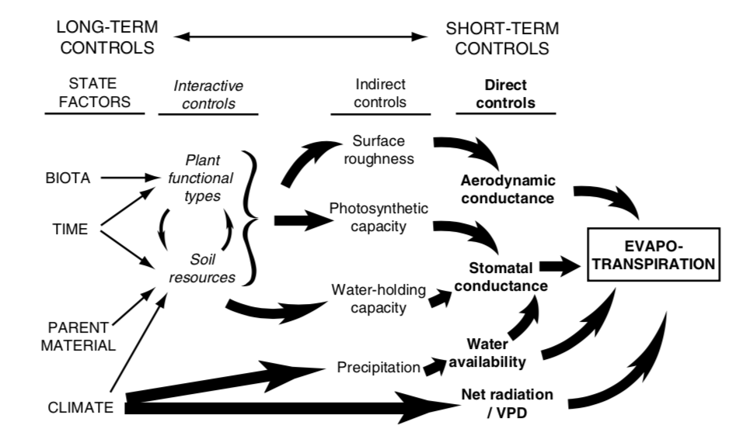
…and a lot of other things!

Slide 48
How does transpiration respond to…
Higher temperatures?
Reduced humidity?
Higher light?
Higher CO₂?

Slide 49
Side bar: Why are there more clouds over the vegetation?

Slide 50
Plant water movement varies by ecosystem due to differential species responses: Isohydry

Slide 51
Isohydry
Isohydric species are sensitive to changes in water availability, quickly closing their stomata in response to drought
Drought avoiders
Maintain high Ψ
Anisohydric species tend to respond more slowly to drought
Drought tolerators
Tolerate low Ψ

Slide 52
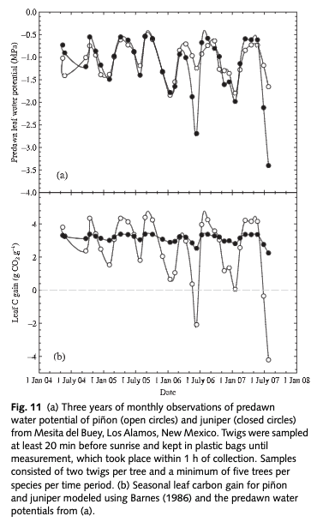
McDowell et al. (2008)

Slide 53
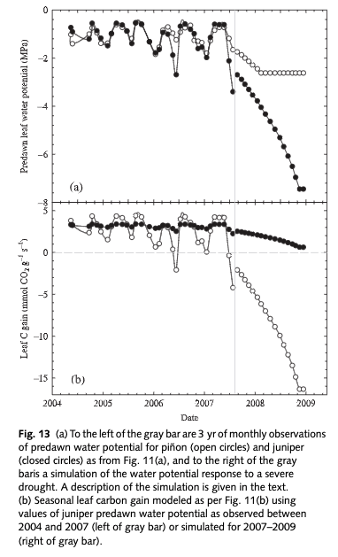
McDowell et al. (2008)

Slide 54
How would isohydry strategy influence the water cycle?

Slide 55
The Water Budget Precipitation +/- Storage = Evapotranspiration + Runoff

Slide 56
The Water Budget Precipitation +/- Storage = Evapotranspiration + Runoff

Slide 57
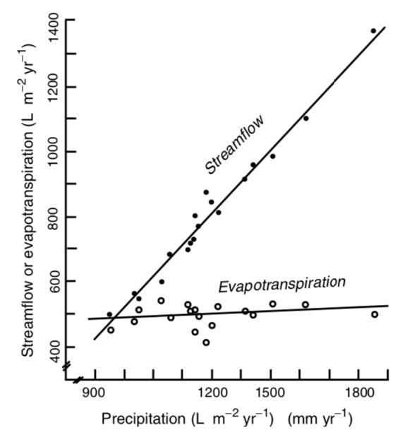
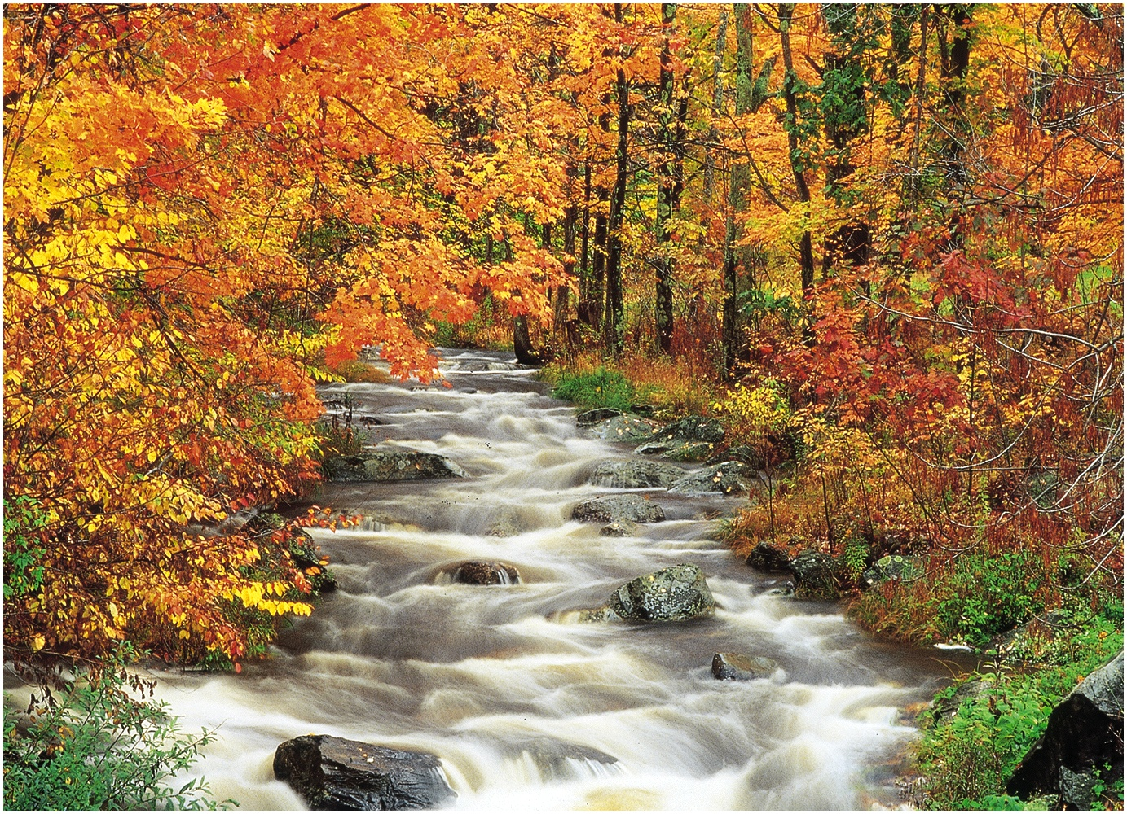
P + ∆S = E + R
P = Precipitation
S = Storage
E = Evapotranspiration
R = Runoff (streamflow)

Slide 58
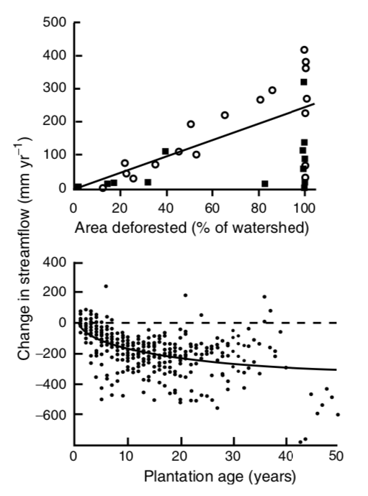
What’s happening here?

Slide 59
Final point: you cannot disentangle energy balance from water balance

Slide 60
Final point: you cannot disentangle energy balance from water balance, the combination determines the climate of an ecosystem

